Slide 1
Network Programming
Spring 2018
Petteri Mäkelä

Slide 2
Network Programming
3 ECTS
40 hours lectures
3rd period
Assessment methods
Exam
Assignments

Slide 3
Network Programming
Learning outcomes
Student can design client-server applications. Student can design concurrent and distributed applications
Contents
Concurrent programs
Threads and synchronization
Client-server model
Socket programming
Supporting technologies
XML and JSON parsing
Handling binary data

Slide 4
Network Programming
Contents in more detail
Threads and concurrent programming
Starting a thread, thread synchronization, producer-consumer model, threads and user interface
Serialization
Binary data in C#
XML
Client-Server model
TCP/IP Socket programming

Slide 5
Updates needed
Wait-async
https://docs.microsoft.com/en-us/dotnet/standard/parallel-programming/index

Slide 6
Threads

Slide 7
Threads
Reading material:
https://docs.microsoft.com/en-us/dotnet/csharp/programming-guide/concepts/threading/
Threading is rather theoretical issue. It is very important that you read about the threads from the web pages and text books

Slide 8
Threads
The advantage of threading is the ability to create applications that use more than one thread of execution.
You can think that there are more than one “programs” running at the same time inside a same program
For example, a process can have a user interface thread that manages interactions with the user and worker threads that perform other tasks while the user interface thread waits for the user input.

Slide 9
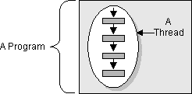
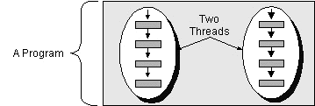
Threads
So far we have written programs having only a single thread (each process have at least one thread)
A thread executes statements sequentially
A program (a process) may have also several threads
Several tasks can be executed simultaneously

Slide 10
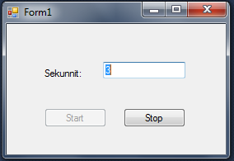
User interface thread and worker thread
The user interface applications may contain a worker thread which performs background actions
The main thread (the UI thread) waits for the user commands
Worker thread
int counter = 0;
while(true) { counter++; Sleep(1000); }
Send counter value to to the UI

Slide 11
Threads - theory
Operating systems use processes to separate the different applications that they are executing.
Threads are the basic unit to which an operating system allocates processor time, and more than one thread can be executing code inside that process.
An operating system that supports preemptive multitasking creates the effect of simultaneous execution of multiple threads from multiple processes.
It does this by dividing the available processor time among the threads that need it, allocating a processor time slice to each thread one after another.

Slide 12
Threads - theory
The currently executing thread is suspended when its time slice elapses, and another thread resumes running.
When the system switches from one thread to another, it saves the thread context of the preempted thread and reloads the saved thread context of the next thread in the thread queue
The length of the time slice depends on the operating system and the processor.
Because each time slice is small, multiple threads appear to be executing at the same time, even if there is only one processor.
This is actually the case on multiprocessor systems, where the executable threads are distributed among the available processors.

Slide 13
When to use multiple threads
Your application could use multiple threads to accomplish the following tasks
Communicate over a network, to a Web server, and to a database.
Network communication and database queries are slow -> other tasks could be performed at the same time when the results are waited
Perform operations that take a large amount of time.
Distinguish tasks of varying priority. For example, a high-priority thread manages time-critical tasks, and a low-priority thread performs other tasks.
Especially in embedded systems
Real Time Operating Systems (RTOS)
Allow the user interface to remain responsive, while allocating time to background tasks.

Slide 14
Examples
User interfaces. The background thread (worker thread) may do the following tasks
Read data from serial port
Communicate with other programs through TCP/IP sockets
Client-Server programming
At the server each client is served in its own thread. By this way the server can response to new client requests while the first client is waiting its response

Slide 15
Threads and Client-Server model
Client 1
Server
UI Thread
request
Main Thread
WorkerThread
Database
Thread serving client 1
Client 2
response
UI Thread
Thread serving client 1
WorkerThread

Slide 16
Disadvantages of multiple threads
It is recommended that you use as few threads as possible, thereby minimizing the use of operating-system resources and improving performance.
Controlling code execution with many threads is complex, and can be a source of many bugs.
Potential problems: deadlocks, race conditions …
Degugging a program with multiple threads is difficult

Slide 17
Creating and starting a thread

Slide 18
Creating and starting a thread
Creating and starting a thread is shown the example in two following slides
The program consists of two classes
Main (the main program)
Worker
Method DoWork will be executed in a separate thread
Try the program by yourself!

Slide 19
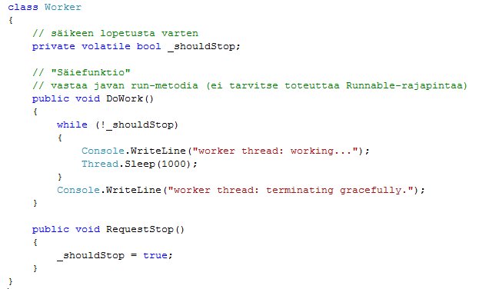
Class for the background thread
A variable which can be used for stopping the thread
The method which is executed in a separate thread

Slide 20
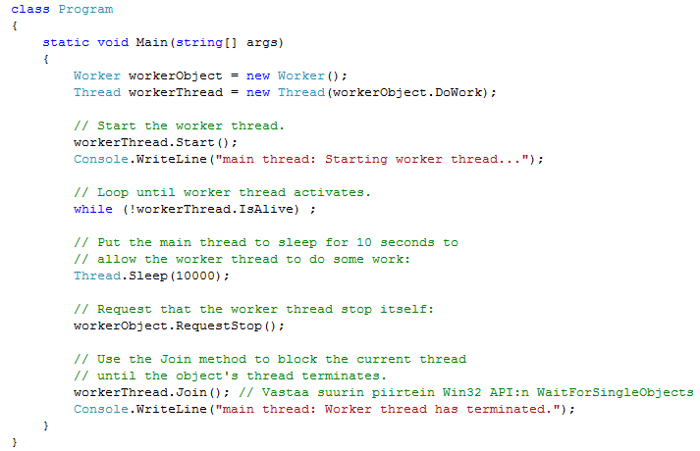
Main program
Create an object of Worker class
Create the thread

Slide 21
Starting a thread
Creating and starting a thread
Thread worker = new Thread(workerObj.DoWork); worker.Start();
Another way to create and start a thread
Thread worker = new Thread( new ThreadStart(workerObj.DoWork)); worker.Start();

Slide 22
Waiting until the thread starts
Method IsAlive() can be used to check whether the thread started is already running
Usually we wait in the main thread that the thread started is running with following loop:
// Spin for a while waiting for the started // thread to become alive: while (!oThread.IsAlive); // note the empty statement

Slide 23
Suspending the thread
Thread.Sleep(int milliseconds) method suspends the current thread for a specified time
The time is given in milliseconds
In our example the main thread goes to suspended state (do nothing) for 10 seconds
There is also a one second sleep in the worker thread
The worker thread should contain always a sleep unless it is blocked by I/O
Busy loop must be avoided
Try to remove the sleep from the worker thread

Slide 24
Terminating the thread
The thread should always stop itself
In some applications the thread method goes to the end of the method when it has completed its task. After executing the last statement the thread is terminated
Sometimes the thread method contains an infinite while loop (as in our example). In this case the thread is stopped by using a boolean variable, whose state is changed from another thread
Use volatile keyword for this variable
The thread can be terminated also from another thread directly, but this should be avoided. The thread should always execute to the end.
Avoid this:Thread.Abort()

Slide 25
Waiting the thread termination
Usually the thread (main) which started another thread (worker) should wait until the another thread has really terminated
This is done by the join method
workerThread.Join();
Join method stops the execution of the current thread (main) and waits while the other thread (worker) is terminated

Slide 26
Exercises
1. Try a busy loop (a thread without sleep)
2. Make a program, which starts two new threads
Thread “A” writes a string “aaaa aaaa aaaa aaaa” to the console
Thread “B” writes a string “bbbb bbbb bbbb bbbb” to the console
Set the sleep time randomly (between 0 and 100 ms)

Slide 27
Exercises
3. Make a program, which starts two new threads
Thread Producer updates contents of object “Data” with random intervals (between 0 and 100 ms)
Thread Consumer outputs the contents of “Data” object to the screen with random intervals (between 0 and 100 ms)
Class Data contains 10 public double type variables, whose values are incremented by one by the producer
Both the Producer and Consumer have access to the same data object.

Slide 28
Producer – Consumer model Thread Synchronization

Slide 29
Thread Synchronization
Thread synchronization is a mechanisms to ensure that two concurrently-executing threads (or processes) do not execute specific portions of a program at the same time
Threads communicate primarily by sharing access to common variables
This form of communication is extremely efficient, but makes two kinds of errors possible: thread interference and memory consistency errors.
The tool needed to prevent these errors is synchronization.

Slide 30
Thread interference
Interference happens when two operations, running in different threads, but acting on the same data, interleave.
This means that the two operations consist of multiple steps, and the sequences of steps overlap.
Examples
http://docs.oracle.com/javase/tutorial/essential/concurrency/interfere.html
Network Programming\Threads\ThreadInterference

Slide 31
Thread interference
See the examples on the previous page!
Interference happens when two operations, running in different threads, but acting on the same data, interleave.
This means that the two operations consist of multiple steps, and the sequences of steps overlap.
It might not seem possible for operations on instances of Counter to interleave, since both operations on c are single, simple statements. However, even simple statements, such as counter++, can translate to multiple steps by the virtual machine (or CLR or C++ ASM):
Retrieve the current value of counter.
Increment the retrieved value by 1.
Store the incremented value back in counter.

Slide 32
Thread interference
Suppose Thread A invokes increment at about the same time Thread B invokes decrement. If the initial value of c is 0, their interleaved actions might follow this sequence:
Thread A: Retrieve c.
Thread B: Retrieve c.
Thread A: Increment retrieved value; result is 1.
Thread B: Decrement retrieved value; result is -1.
Thread A: Store result in c; c is now 1.
Thread B: Store result in c; c is now -1.

Slide 33
Thread interference
In C# incrementing and decrementing are not necessarily atomic.
Other thread may modify the same variable while the incrementing (consisting perhaps from 3 steps) is in process
The problem can be avoid by using
lock or Monitor.Enter and Monitor.Exit
Try it
Atomic increment and decrement can be done also with special methods
Interlocked.Increment(ref counter);
Interlocked.Decrement(ref counter);
Note that assignment of 32-bit variable is an atomic operation
int a = 22; // atomic

Slide 34
Thread interference – Atomic operations in C#
C# specification:
Reads and writes of the following data types shall be atomic: bool, char, byte, sbyte, short, ushort, uint, int, float, and reference types.
There is no guarantee of atomic read-modify-write, such as in the case of increment or decrement
Read/write on a field of 32-bit or less is always atomic, operations on 64-bit are guaranteed to be atomic only in 64-bit OS, statements that combine more than one read/write operation are never atomic
Examples
int i = 3; // Always atomic long l = Int64.MaxValue; // Atomic in 64-bit // enviroment, non-atomic on 32-bit environment
int i = 0; int j += i; // Non-atomic, read and write operation i++; // Non-atomic, read and write operation

Slide 35
Memory consistency errors
Memory consistency errors occur when different threads have inconsistent views of what should be the same data.
See the example and try to run it: Network Programming\Threads\ProducerConsumer0
The consumer should print the time stamp and the corresponding measurements at once
However, from the output you can see that the measurements may sometimes be newer than the time stamp
Sometimes the Producer thread updates the measurements when the Consumer’s printing process is still going

Slide 36
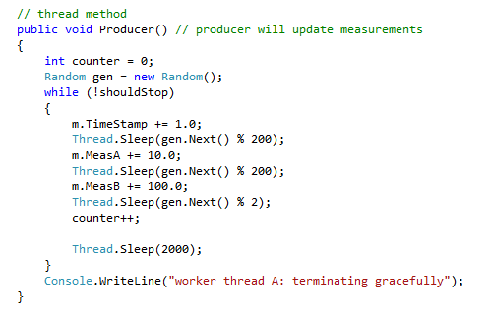
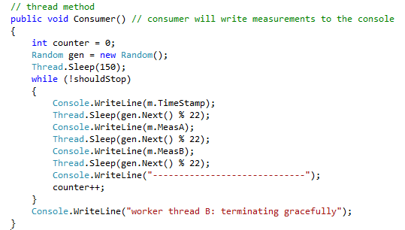
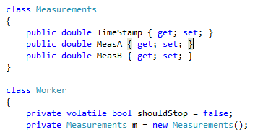
Thread producer updates the measurements
Thread consumer writes the measurements to the screen
The producer may update the measurements at the same time as the consumer’s writing process is still going
As a result the measurements printed are not necessarily consistent with each other (measurements may not correspond the time stamp)
Network Programming\Threads\ProducerConsumer0

Slide 37
Thread synchronization
The asynchronous nature of threads means that access to resources such as file handles, network connections, and memory (variables) must be coordinated.
Otherwise, two or more threads could access the same resource at the same time, each unaware of the other's actions. The result is unpredictable data corruption.
For simple operations on integral numeric data types, synchronizing threads can be accomplished with members of the Interlocked class
Usually other mechanisms are needed
lock keyword
Monitor class
Mutex, Semaphore

Slide 38
Synchronization with lock keyword
The lock statement can be used to ensure that a block of code runs to completion without interruption by other threads.
This is accomplished by obtaining a mutual-exclusion lock for a given object for the duration of the code block.
Usually we create single instance of class object, which will be locked for synchronization purposes
private object lockThis = new object();

Slide 39
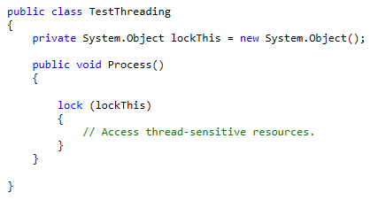
Synchronization with lock keyword
The critical section can be implemented now as follows

Slide 40
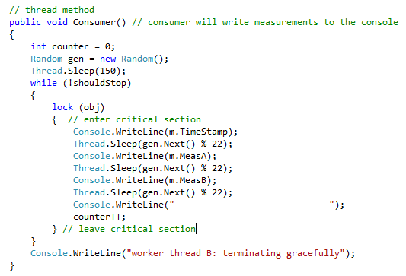
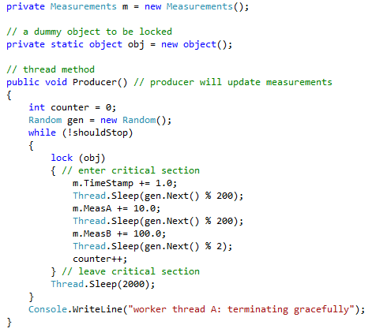
Synchronization with lock keyword
The program ProducerConsumer0 can be corrected now with lock so that the time stamp and the measurements will be consistent

Slide 41
Synchronization with lock keyword
The corrected version can be found from ”Network Programming\Threads\ProducerConsumer1a”
Now the handling of the measurements is protected with the lock keyword.
If the consumer thread is writing to the screen (has reserved the lock) the producer thread waits at the lock statement
After the consumer has finished the writing it releases the lock. The producer stops waiting and reserves the lock for updating the values

Slide 42
Synchronization with lock keyword
The approach of the program ProducerConsumer1a can be utilized in many situations
For example, the producer may be connected to some sensor. The consumer may read the newest measurements once per second and send them forwards
The locking mechanism take care that the data transferred is always consistent
update
Read
Producer
(produces data)
Consumer
(consumes data, e.g., writes data to the screen
Measurements double timeStamp
double measA double measB

Slide 43
Producer Consumer – Version 1
The previous program is named as ProducerConsumer1a. This is the first version of a general Producer Consumer model. This version takes only care that the data is consistent. In many applications this sufficient.
With this version a situation called race condition (Finnish kilpatilanne) may occur
If the Producer is faster than the Consumer, the Consumer losts some data
If the Consumer is faster than the Producer, the Consumer may print the same data (measurements with the same time stamp) twice
In many applications, the race condition is not a problem. Quite often it is OK, that the Consumer gets only the newest measurement.

Slide 44
Race Condition
Producer is faster than the Consumer
Consumer output (data is lost):
Time = 1, MeasA = 10; MeasB = 100;
Time = 3, MeasA = 30; MeasB = 300;
Time = 8, MeasA = 80; MeasB = 800;
Consumer is faster than the Producer
Consumer output (some data is written twice):
Time = 1, MeasA = 10; MeasB = 100;
Time = 1, MeasA = 10; MeasB = 100;
Time = 2, MeasA = 20; MeasB = 200;

Slide 45
Synchronization with Monitor class
The Monitor class can be used instead of lock keyword for thread synchronization
The following examples are equal
lock (obj) { DoSomething(); }
Monitor.Enter(obj); try { DoSomething(); } finally { System.Threading.Monitor.Exit(obj); }
See example ProducerConsumer1b

Slide 46
Producer – Consumer Model Version 2

Slide 47
Producer – Consumer Model
http://msdn.microsoft.com/en-us/library/aa645740(v=vs.71).aspx#vcwlkthreadingtutorialexample2synchronizing
Producer
Consumer
”Buffer”
data
Put()
Get()

Slide 48
Producer Consumer Model Version 2
In actual Producer Consumer model the race condition is not accepted
In the version 2 of our model we have the following requirements:
1. The data stays always consistent
2. No data provided by the Producer is lost
3. No data is written twice by the Consumer

Slide 49
Producer Consumer Model Version 2
The requirements 1 was taken care already in the version 1 by lock keyword.
To satisfy the requirements 2 and 3 the Producer and the Consumer must co-operate
The producer must tell to the consumer that a new measurement is ready
The consumer can read a new measurement
The consumer must tell to the producer that it has read the new measurement
The producer can produce a new measurement
Neither producer nor consumer may use much processing power for waiting
The co-operation is implemeted by methods Pulse and Wait of Monitor class

Slide 50
Producer Consumer Model Version 2
Consumer waits new data
Producer produces new data and notifies Consumer that there is new data
Consumer stops waiting and consumes the new data (calls get() method)
Consumer notifies the producer that it has read the data
Monitor.Notify()
Producer
(produces data)
Consumer
(consumes data)
Put()
Measurements double timeStamp
double measA double measB
Get()
Monitor.Notify()

Slide 51
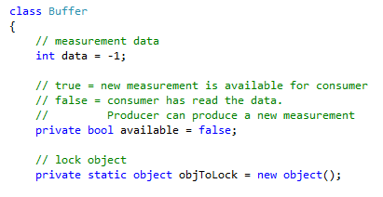
Class Buffer
Class Buffer is used to transfer the data between the Producer and consumer (sometimes named as ”Cubbyhole”)
Member variables:
Methods
Put for Producer
Get for Consumer

Slide 52
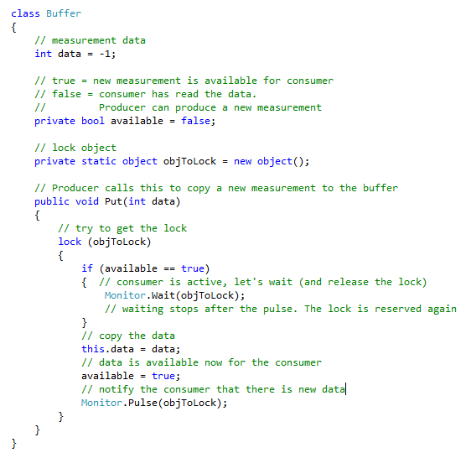
Put method for the Producer

Slide 53
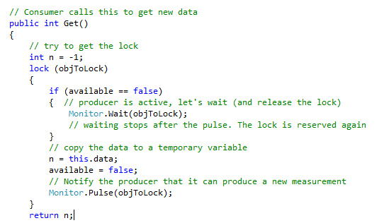
Get method for the Consumer
Network Programming\Threads\ProducerConsumer2

Slide 54
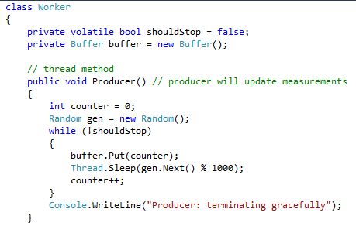
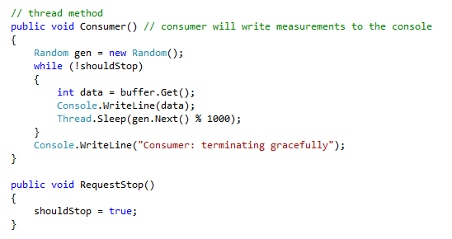
Producer and Consumer threads

Slide 55
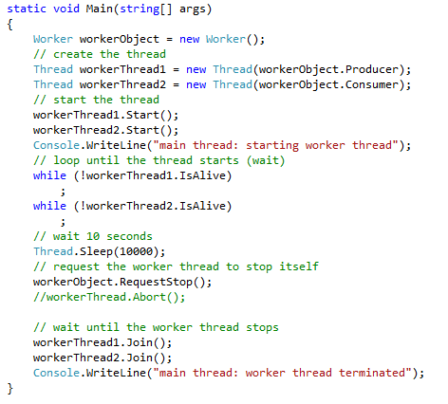
Main method
Main method is the same as in previous examples
It starts the producer and consumer threads

Slide 56
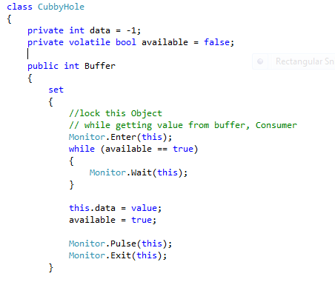
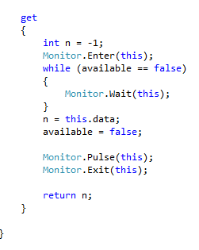
Another approach
Monitor.Enter and Monitor.Exit used instead of lock keyword

Slide 57
Buffered Producer Consumer Version 3

Slide 58
Buffered Producer Consumer
The actual Producer Consumer model is not suitable for some applications
The problem is that the producer must wait consumer to consume the previous data before new data can be produced
Quite often this is not possible. In some applications the producer generates new data independently. It can’t wait any other tasks
The solution is to add a buffer (Queue) between the producer and consumer

Slide 59
Buffered Producer Consumer
In the buffered version the producer does not wait consumer.
The producer produces new data at its own speed. The data is written to a queue data structure (FIFO)
The producer writes data to the buffer and notifies the consumer that there is new data
The consumer stops waiting after the notification and tries to read the buffer empty
The consumer does not notify the producer. The producer does not wait the consumer
Producer
(produces data)
Consumer
(consumes data)
Put()
Measurement buffer (Queue)
Get()
Monitor.Notify()

Slide 60
Buffered Producer Consumer
If the producer is faster than the consumer, the size of the buffer grows
Obviously, the consumer must be faster than the producer in the long run
Producer
(produces data)
Consumer
(consumes data)
Put()
Measurement buffer (Queue)
Get()
Monitor.Notify()

Slide 61
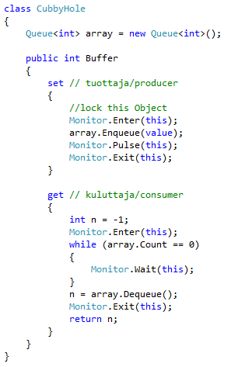
Buffered Producer Consumer
Here is one version of the buffer class
Try to do your own version using lock keyword
Modify the consumer so that it is occasionally slower than the producer

Slide 62
Exercise
Modify the version 2 so that it uses queue (FIFO)
The solution is stored here:
Network Programming\Threads\ProducerConsumer3FIFO
Modify the program so that the producer produces data sometimes in bursts
Observe the length of the buffer

Slide 63
Buffered Producer Consumer with Timeout Version 4

Slide 64
Buffered Producer Consumer with Timeout - Version 4
Version 3 has still some limitations. If the producer stops producing data, the consumer thread will block
The consumer stays at the Monitor.Wait of the Get method
Usually the consumer thread has also other tasks to do. It’s execution can’t be blocked to the Monitor.Wait method
The solution is to set an upper limit for the wait time. The time-out value of the method Monitor.Wait can be set as a parameter

Slide 65
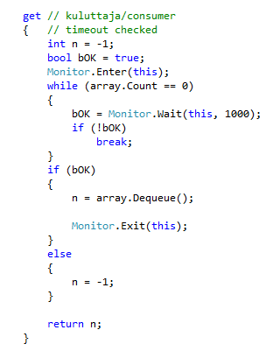
Time-out of Monitor.Wait
The time-out value of the Monitor.Wait method is given as a parameter
In this example the consumer waits at most one second.
If Monitor.Wait goes to time-out, it returns false

Slide 66
Exercise
Modify the version 3 so that it has time-out
Modify the consumer thread so that you will see, when the time-out occurs
Version 4 is stored to directory:
Network Programming\Threads\ProducerConsumer4FIFOTimeout

Slide 67
Deadlock

Slide 68
Deadlock
One potential problem in multithreaded applications is situation called deadlock
Deadlock describes a situation where two or more threads are blocked forever, waiting for each other
Deadlock happens when two threads are waiting for a lock owned by the other

Slide 69
Deadlock example 1
One example of deadlock situation can be found from http://www.yoda.arachsys.com/csharp/threads/deadlocks.shtml
Deadlocks are difficult to debug - they're hard to diagnose, they can crop up seemingly randomly (i.e. they're hard to reproduce)
The solution (which is easier to describe than to achieve) is to make sure that you always take out locks in the same order: in the example, you might decide to never acquire secondLock unless you already had firstLock.
Example is in directory
Network Programming\Threads\Deadlock

Slide 70
Extra
Dining philosphers proglem
http://en.wikipedia.org/wiki/Dining_philosophers_problem

Slide 71
User Interface and background thread

Slide 72
User Interface and background thread
When performing any action on a control which requires the updating of a user interface element, these operations must take place on the thread that created the UI element.
As an example, the background is not allowed to update the properties of the user interface controls.
The UI controls can be modified only at the UI thread (usually the “main” thread, which also created the UI controls)

Slide 73
User interface and background thread
The user interface applications may contain a worker thread which performs background actions
The main thread (the UI thread) waits for the user commands
Worker thread
Do some background operation, such as
Read RS port
Read TCP/IP socket
Other I/O
Send data to to the UI

Slide 74
User Interface and background thread
All the user interface controls (TextBox, Button etc) are derived from the class Control
The Control class provides the Invoke method, which will take a delegate and execute it on the thread that the UI element was created on.
In order to use this, one must declare a function that performs the UI operation.
Example:
http://blogs.msdn.com/b/csharpfaq/archive/2004/03/17/91685.aspx

Slide 75
Example
Study the program Timer (Network Programming\Threads\Timer)

Slide 76
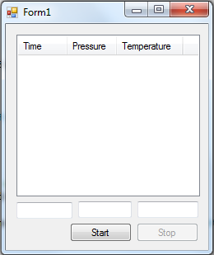
Exercise
Make a program, which reads measurements (from somewhere) once per second. The measurements are shown in a listview (in tabular format)
Show the data also in graphical form (divide the form with Splitter and use ZedGraph to show the graphics)
Example: Network Programming\Threads\UIandMeasurements
Listview:
http://www.c-sharpcorner.com/UploadFile/mgold/ListViewInCSharp11172005021741AM/ListViewInCSharp.aspx
Network Programming\Threads\ListViewTestiExample

Slide 77
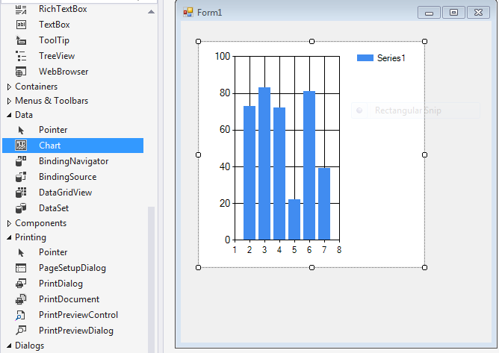
Exercise
Yhdistä harjoitukset
Timer ja
ListViewExample (ota tämä pohjaksi)
Kokeile piirtää käppyrää myös graafisessa muodossa (Toolbox->Data->Chart)

